Slide 1

MService MSCTD-657
Confidential to Selfservit Solutions

Slide 2
Checklist
1.Handover Documents .

Slide 3
Repository Name:
1.DELAVAL-in_LIVE

Slide 4
TEST ENVIRONMENT DETAILS: URL : https://delaval-in-uat.mservice.net/ Co-ordinator login : oemcoord1/test

Slide 5
Impact Analysis:
The files which is going to add and modify is
DB/DATA SCRIPTS/FR-2261/01.grant_permission.sql
DB/DATA SCRIPTS/FR-2261/02.insert.sql
DB/PROCEDURES/dbo.sp_retrieve_manage_custom_info_list_mserviceAI_escalationList_delaval_in.sql
DB/PROCEDURES/dbo.sp_save_manage_custom_info_mserviceAI.StoredProcedure.sql
Website/common/scripts/js/rule_engine_functions.js
Website/common/scripts/js/webScreenController.library.js
Website/common/scripts/js/webWidgetInitializer.library.js
Website/webui/configuration/rule/rule_manage_call_register_edit_delaval_in.txt
Website/webui/configuration/rule/rule_manage_call_register_pe_edit_delaval_in.txt
Website/webui/configuration/rule/rule_manage_call_register_sa_edit_delaval_in.txt
Website/webui/configuration/rule/rule_manage_call_register_se_edit_delaval_in.txt
Website/webui/configuration/rule/rule_manage_call_register_vi_edit_delaval_in.txt
Website/webui/configuration/rule/rule_manage_customer_contacts_edit_delaval_in.txt
Website/webui/configuration/rule/rule_manage_customer_location_edit_delaval_in.txt
Website/webui/configuration/rule/rule_manage_customer_master_edit_delaval_in.txt
Website/webui/configuration/rule/rule_manage_employee_master_edit_delaval_in.txt
Website/webui/html/manage_call_register_edit.html

Slide 6
Impact Analysis:
The files which is going to add and modify is
Website/webui/html/manage_call_register_pe_edit.html
Website/webui/html/manage_call_register_sa_edit.html
Website/webui/html/manage_call_register_se_edit.html
Website/webui/html/manage_call_register_vi_edit.html
Website/webui/html/manage_customer_location_edit.html
Website/webui/html/manage_customer_master_edit.html
Website/webui/html/manage_employee_master_edit.html
Website/webui/scripts/js/fn_manage_call_register_edit.js
Website/webui/scripts/js/fn_manage_call_register_pe_edit.js
Website/webui/scripts/js/fn_manage_call_register_sa_edit.js
Website/webui/scripts/js/fn_manage_call_register_se_edit.js
Website/webui/scripts/js/fn_manage_call_register_vi_edit.js
Website/webui/scripts/js/fn_manage_customer_contacts_edit.js
Website/webui/scripts/js/fn_manage_customer_location_edit.js
Website/webui/scripts/js/fn_manage_customer_master_edit.js
Website/webui/scripts/js/fn_manage_employee_master_edit.js
Website/www/configuration/controller/delaval/in/controller_my_activities_closed_delaval_in.json
Website/www/configuration/controller/delaval/in/controller_my_activities_open_delaval_in.json

Slide 7
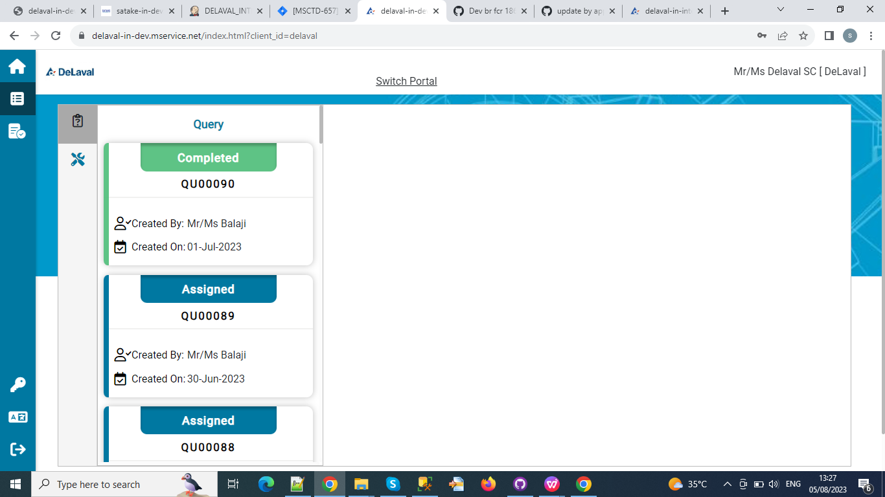

Slide 8
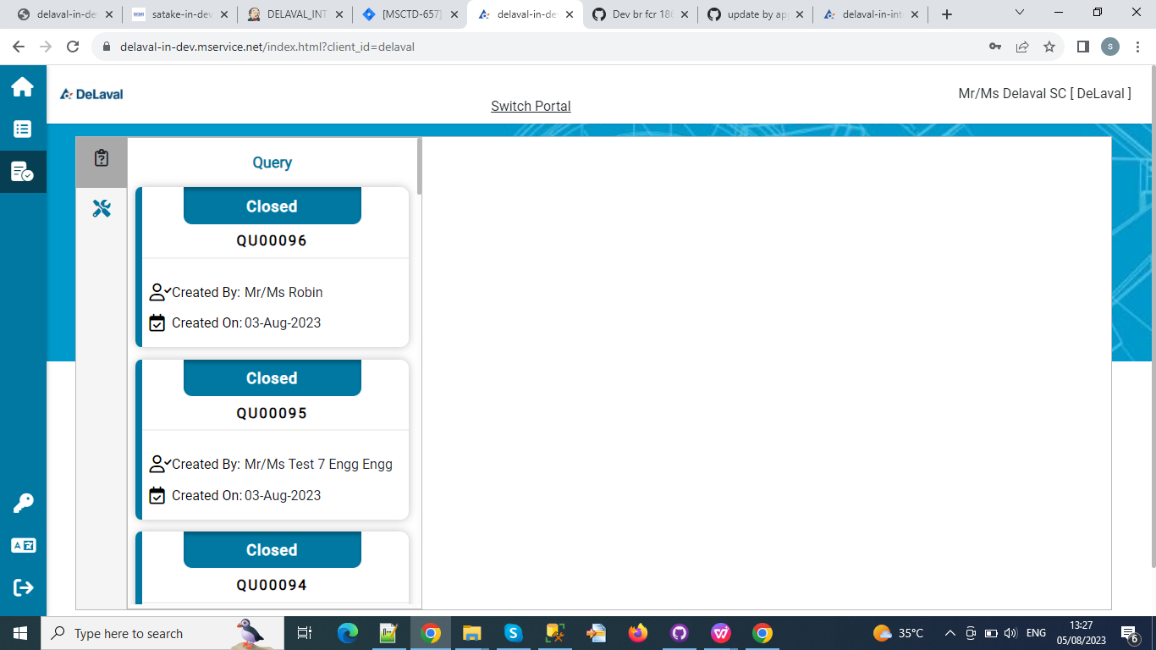

Slide 9
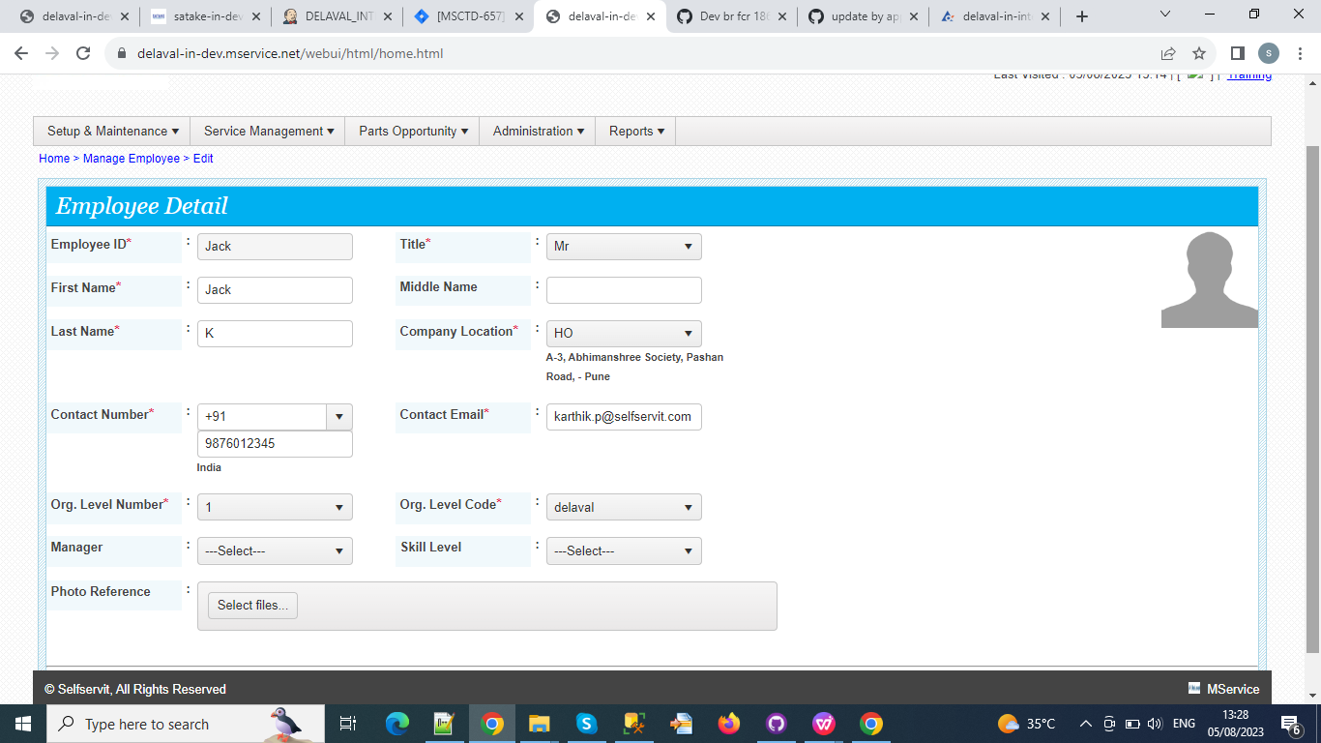

Slide 10
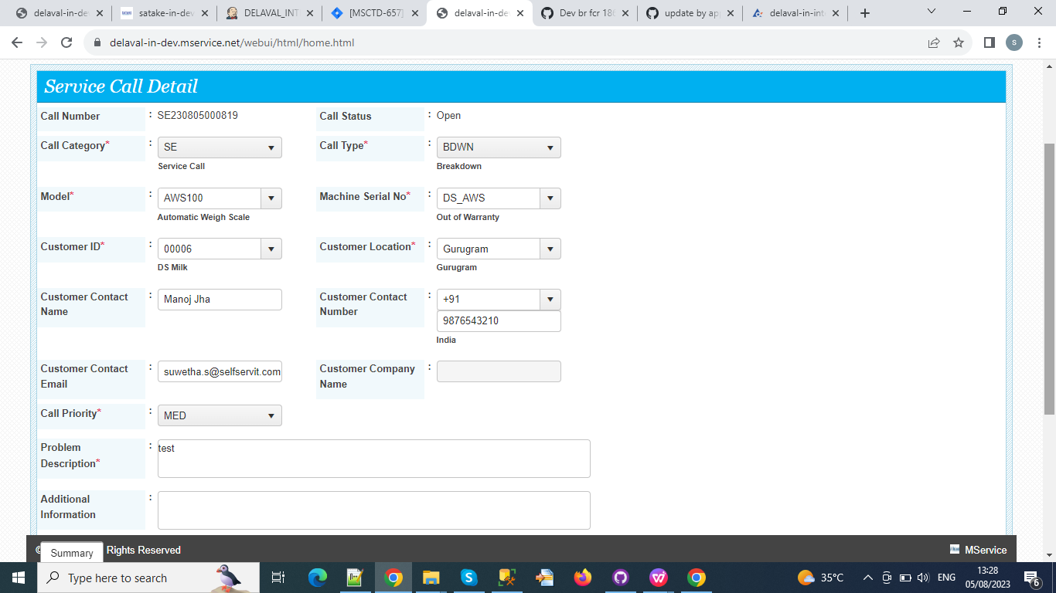

Slide 11
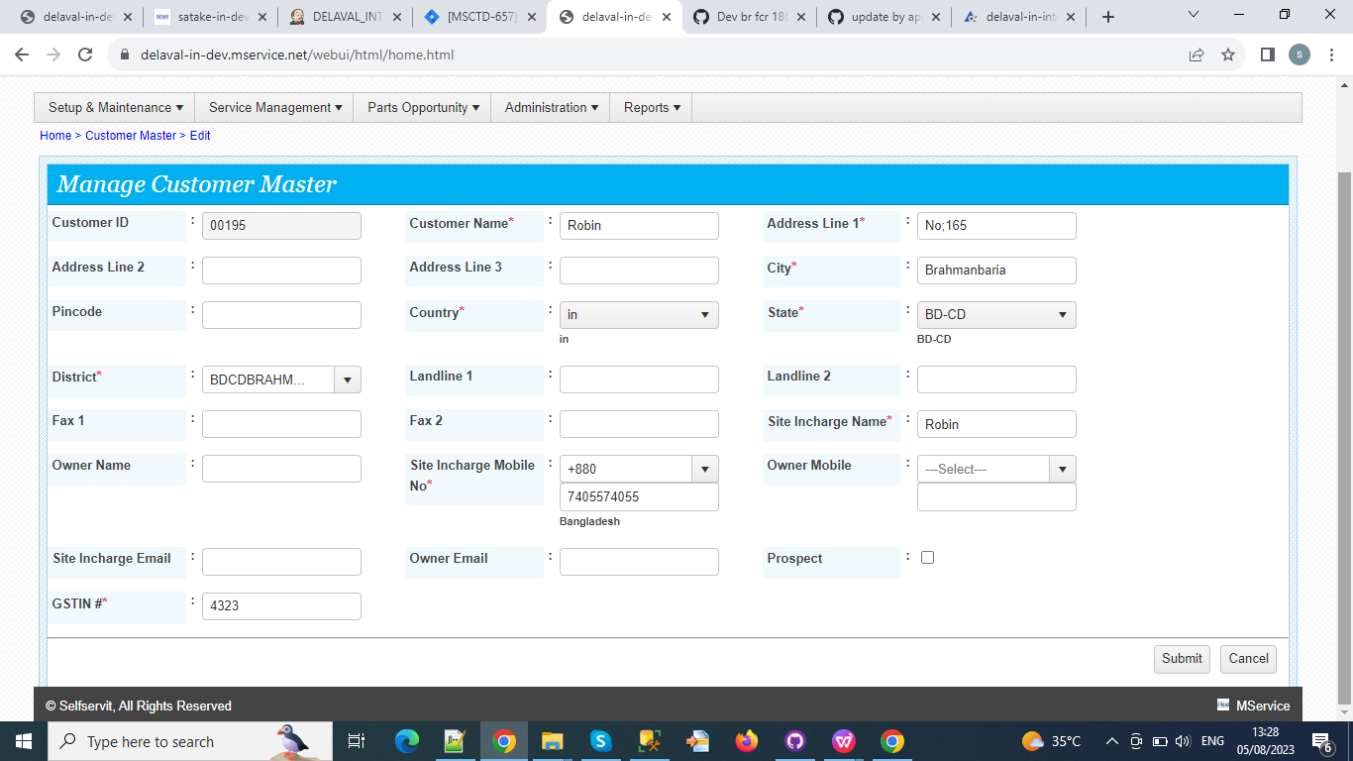

Slide 12
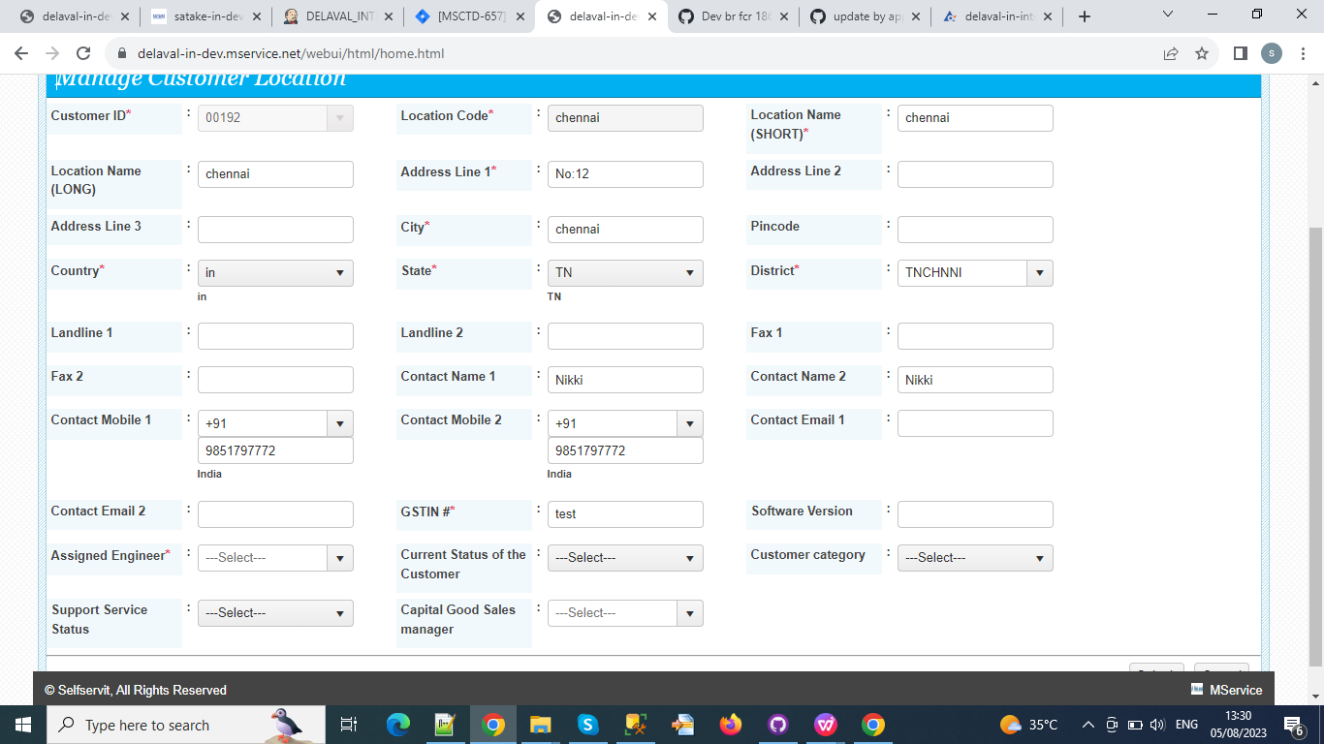

Slide 13
